Slide 1
Circuit Theorems
Circuit Theorems

Slide 2
Chap. 4 Circuit Theorems
Introduction
Linearity property
Superposition
Source transformations
Thevenin’s theorem
Norton’s theorem
Maximum power transfer
Circuit Theorems

Slide 3
4.1 Introduction
A large
complex circuits
Simplify
circuit analysis
Circuit Theorems
‧Thevenin’s theorem ‧ Norton theorem
‧Circuit linearity ‧ Superposition
‧source transformation ‧ max. power transfer
Circuit Theorems

Slide 4




4.2 Linearity Property
Homogeneity property (Scaling)
Additivity property
Circuit Theorems

Slide 5
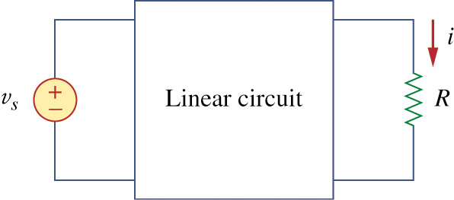
A linear circuit is one whose output is linearly related (or directly proportional) to its input
Fig. 4.1
i
v
V₀
I₀
Circuit Theorems

Slide 6
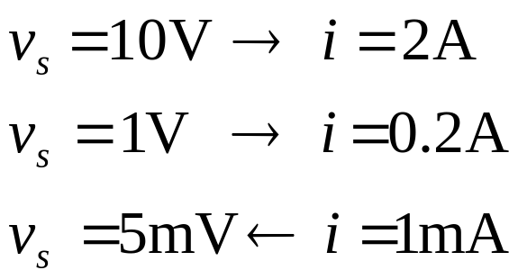
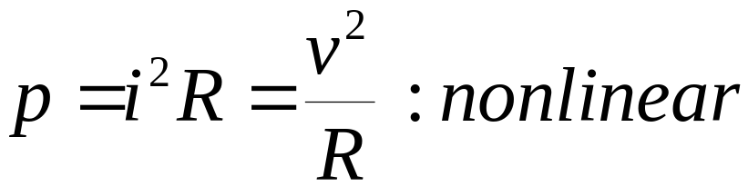
Linear circuit consist of
  linear elements
  linear dependent sources
  independent sources
Circuit Theorems

Slide 7
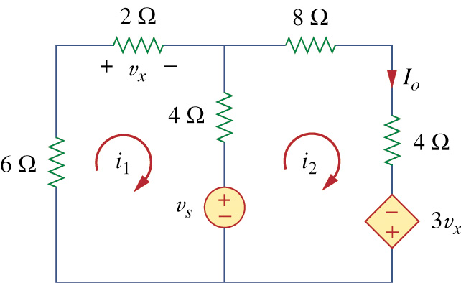
Example 4.1
For the circuit in fig 4.2 find I₀ when v_{s}=12V and v_{s}=24V.
Circuit Theorems
Eastern Meiterranean University

Slide 8
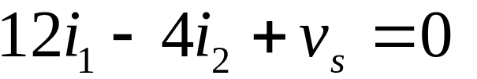
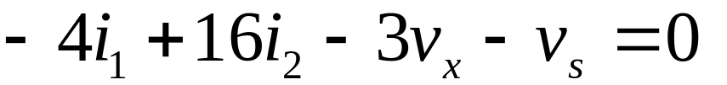
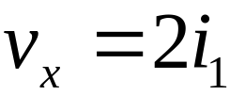

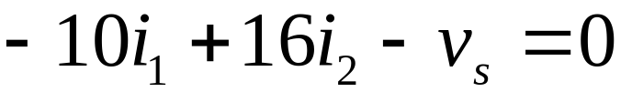

Example 4.1
KVL
Eqs(4.1.1) and (4.1.3) we get
(4.1.1)
(4.1.2)
(4.1.3)
Circuit Theorems

Slide 9
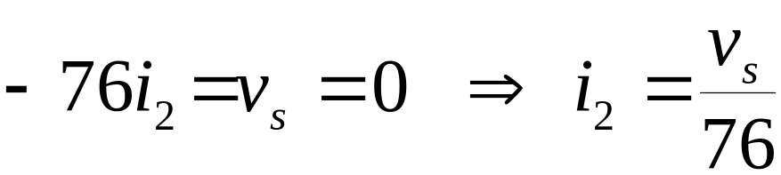
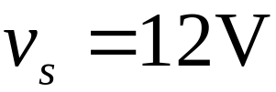
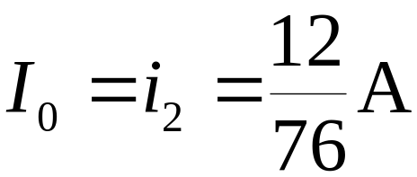
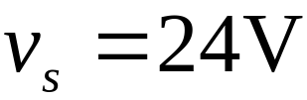
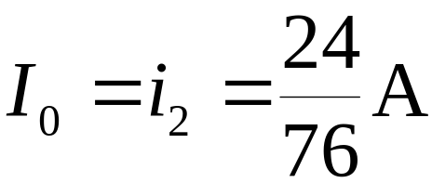
Example 4.1
Eq(4.1.1), we get
When
When
Showing that when the source value is doubled, I₀ doubles.
Circuit Theorems

Slide 10
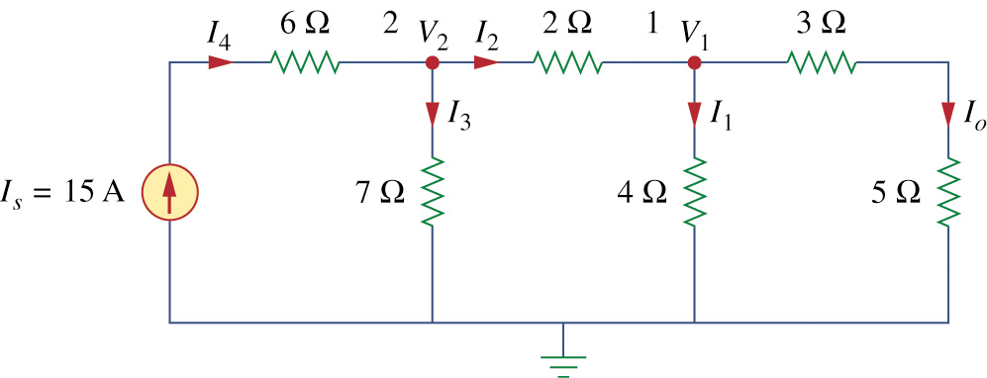
Example 4.2
Assume I₀ = 1 A and use linearity to find the actual value of I₀ in the circuit in fig 4.4.
Circuit Theorems

Slide 11
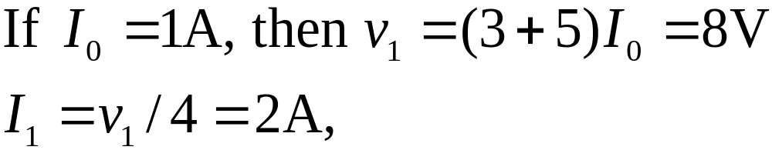
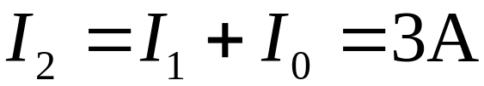
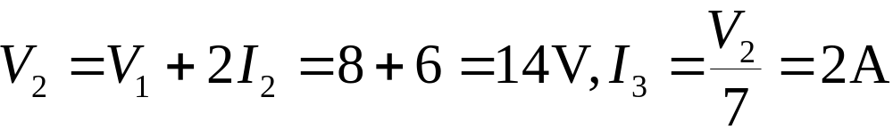
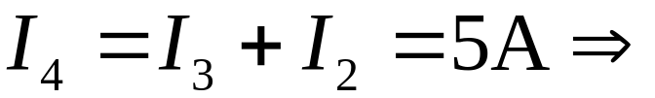
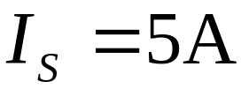
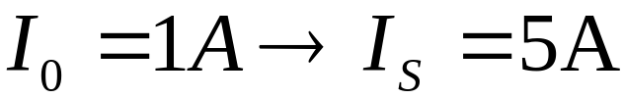
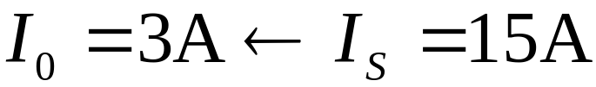
Example 4.2
Circuit Theorems

Slide 12
4.3 Superposition
The superposition principle states that the voltage across (or current through) an element in a linear circuit is the algebraic sum of the voltages across (or currents through) that element due to each independent source acting alone.
Turn off, killed, inactive source:
  independent voltage source: 0 V (short circuit)
  independent current source: 0 A (open circuit)
Dependent sources are left intact.
Circuit Theorems

Slide 13
Steps to apply superposition principle:
  Turn off all independent sources except one source. Find the output (voltage or current) due to that active source using nodal or mesh analysis.
  Repeat step 1 for each of the other independent sources.
  Find the total contribution by adding algebraically all the contributions due to the independent sources.
Circuit Theorems
Eastern Mediterranean University

Slide 14
How to turn off independent sources
Turn off voltages sources = short voltage sources; make it equal to zero voltage
Turn off current sources = open current sources; make it equal to zero current
Circuit Theorems
Eastern Mediterranean University

Slide 15
Superposition involves more work but simpler circuits.
Superposition is not applicable to the effect on power.
Circuit Theorems
Eastern Mediterranean University

Slide 16
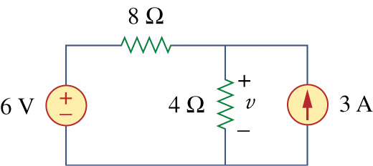
Example 4.3
Use the superposition theorem to find in the circuit in Fig.4.6.
Circuit Theorems

Slide 17
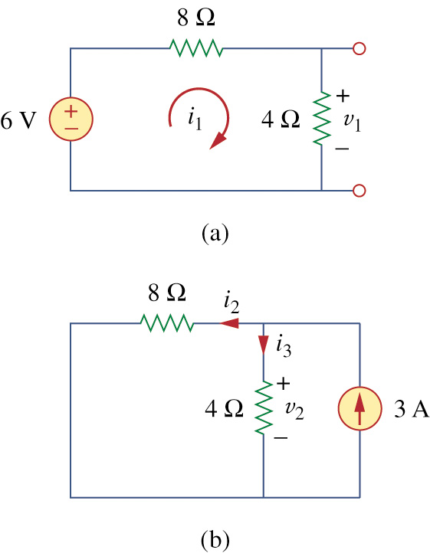

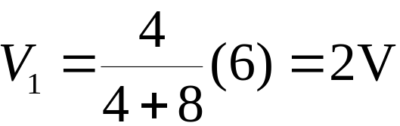
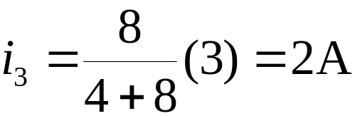
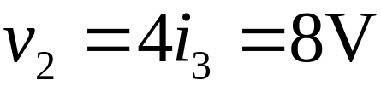

Example 4.3
Since there are two sources,
let
Voltage division to get
Current division, to get
Hence
And we find
Circuit Theorems

Slide 18
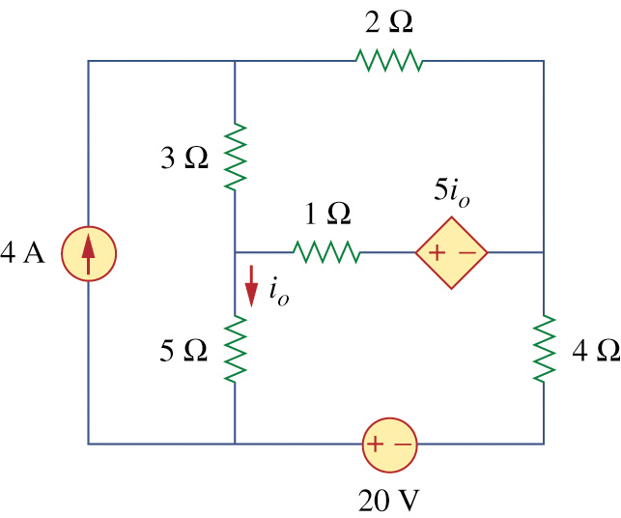
Example 4.4
Find I₀ in the circuit in Fig.4.9 using superposition.
Circuit Theorems

Slide 19
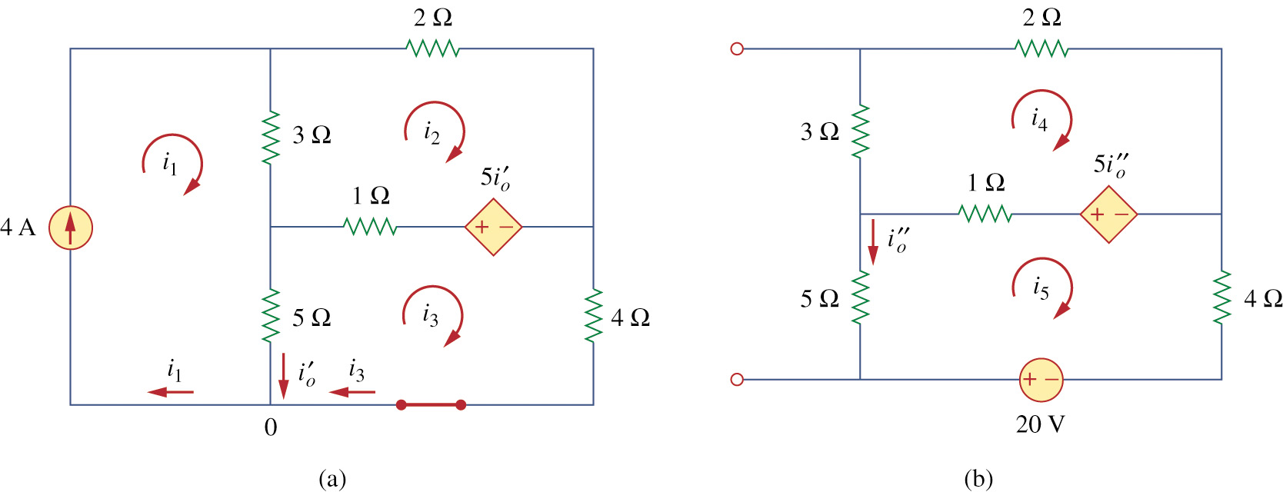
Example 4.4
Fig. 4.10
Circuit Theorems

Slide 20
Example 4.4
Fig. 4.10
Circuit Theorems

Slide 21
4.5 Source Transformation
A source transformation is the process of replacing a voltage source v_{s} in series with a resistor R by a current source i_{s} in parallel with a resistor R, or vice versa
Circuit Theorems
Eastern Mediterranean University

Slide 22
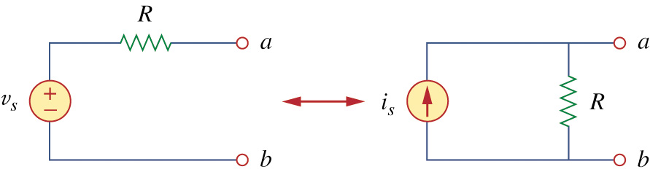
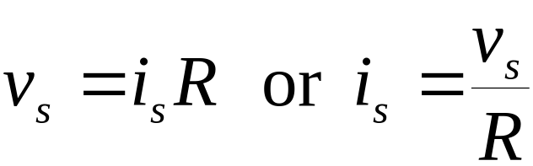
Fig. 4.15 & 4.16
Circuit Theorems
Eastern Mediterranean University

Slide 23
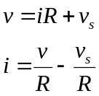
Equivalent Circuits
i
i
+
+
v
v
-
-
i
v
v_{s}
-i_{s}
Circuit Theorems

Slide 24
Arrow of the current source
positive terminal of voltage source
Impossible source Transformation
  ideal voltage source (R = 0)
  ideal current source (R=∞)
Circuit Theorems

Slide 25
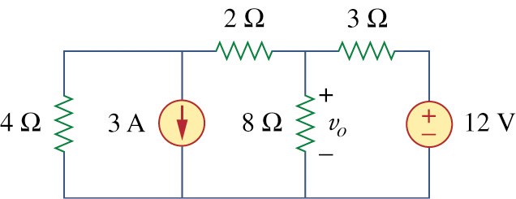
Example 4.6
Use source transformation to find v_{o} in the circuit in Fig 4.17.
Circuit Theorems

Slide 26
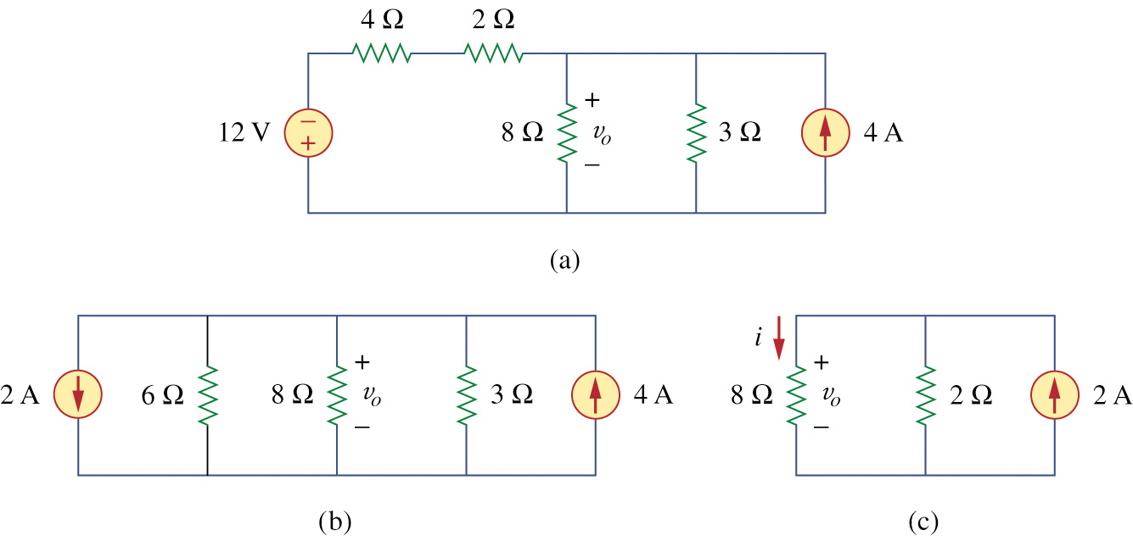
Example 4.6
Fig 4.18
Circuit Theorems

Slide 27
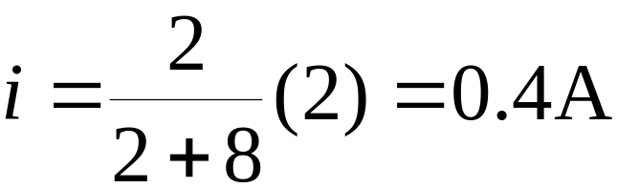
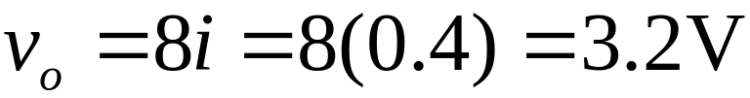
Example 4.6
we use current division in Fig.4.18(c) to get
and
Circuit Theorems

Slide 28
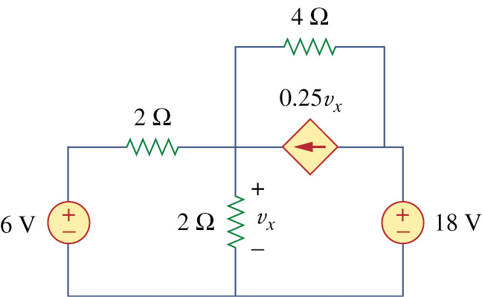
Example 4.7
Find v_{x} in Fig.4.20 using source transformation
Circuit Theorems

Slide 29
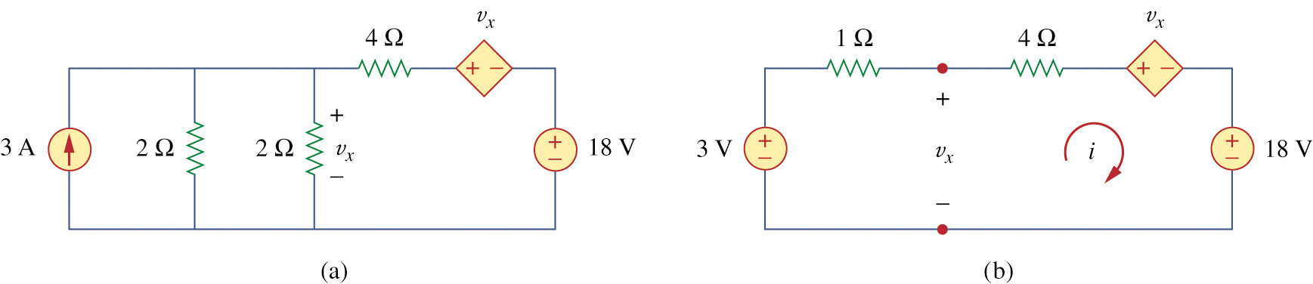
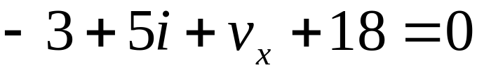

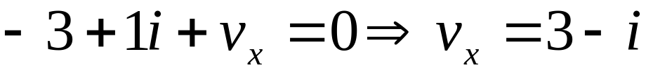
Example 4.7
Applying KVL around the loop in Fig 4.21(b) gives
(4.7.1)
Appling KVL to the loop containing only the 3V voltage source, the resistor, and v_{x} yields
(4.7.2)
Circuit Theorems

Slide 30
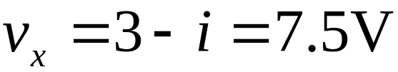
Example 4.7
Substituting this into Eq.(4.7.1), we obtain
Alternatively
thus
Circuit Theorems

Slide 31
4.5 Thevenin’s Theorem
Thevenin’s theorem states that a linear two-terminal circuit can be replaced by an equivalent circuit consisting of a voltage source V_{Th} in series with a resistor R_{Th} where V_{Th} is the open circuit voltage at the terminals and R_{Th} is the input or equivalent resistance at the terminals when the independent source are turn off.
Circuit Theorems

Slide 32
Property of Linear Circuits
i
i
+
Any two-terminal
Linear Circuits
v
Slope=1/R_{th}
-
v
V_{th}
I_{sc}
Circuit Theorems

Slide 33
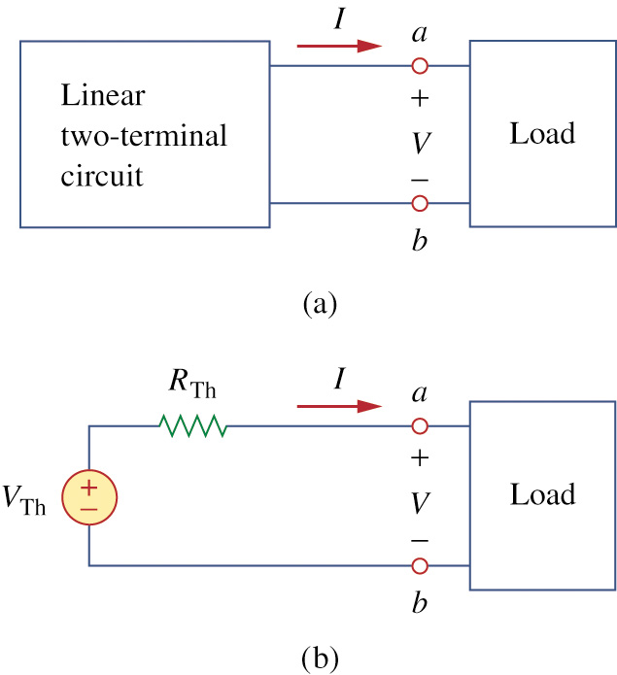
Fig. 4.23
Circuit Theorems

Slide 34
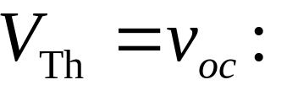
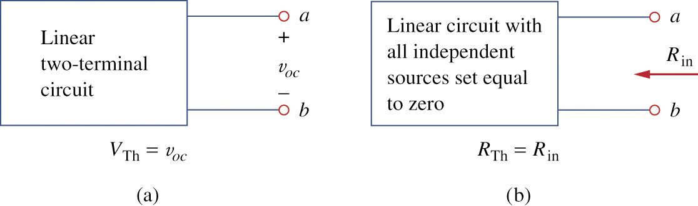
How to Find Thevenin’s Voltage
Equivalent circuit: same voltage-current relation at the terminals.
Circuit Theorems

Slide 35


How to Find Thevenin’s Resistance
Circuit Theorems

Slide 36
CASE 1
If the network has no dependent sources:
  Turn off all independent source.
  R_{TH}: can be obtained via simplification of either parallel or series connection seen from a-b
Circuit Theorems

Slide 37
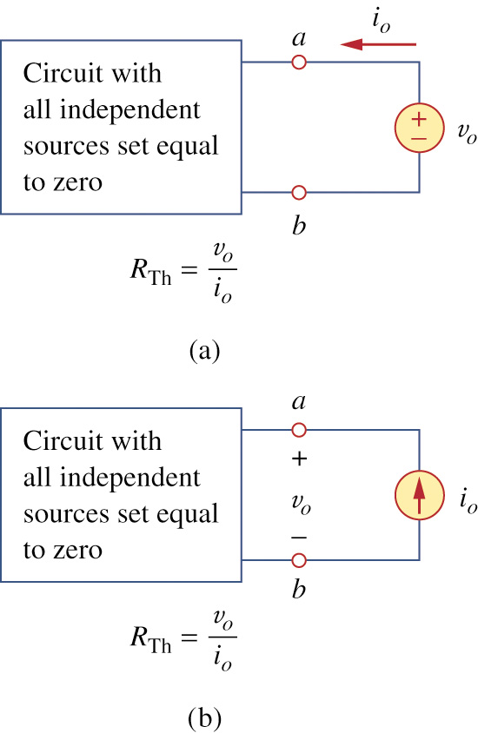
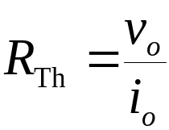
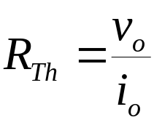
Fig. 4.25
CASE 2
If the network has dependent sources
  Turn off all independent sources.
  Apply a voltage source v_{o} at a-b
  Alternatively, apply a current source i_{o} at a-b
Circuit Theorems

Slide 38
The Thevenin’s resistance may be negative, indicating that the circuit has ability providing power
Circuit Theorems

Slide 39
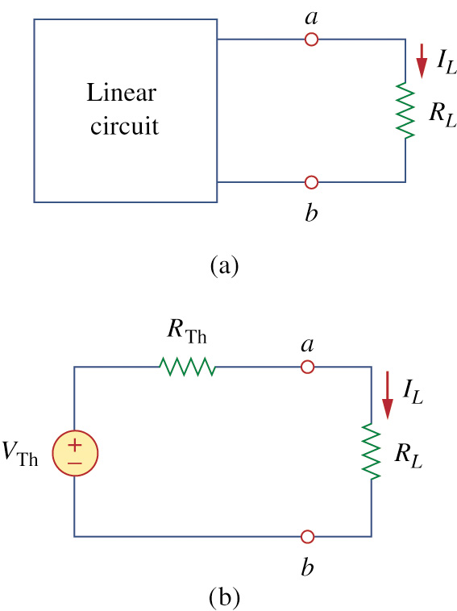
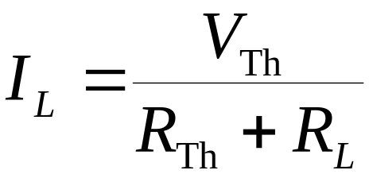
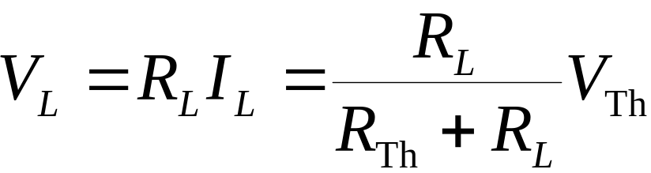
Fig. 4.26
Simplified circuit
Voltage divider
Circuit Theorems

Slide 40
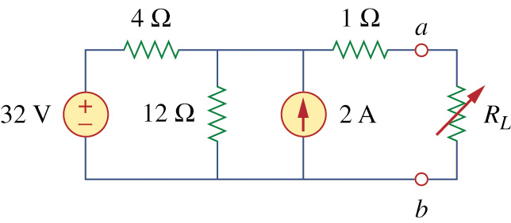
Example 4.8
Find the Thevenin’s equivalent circuit of the circuit shown in Fig 4.27, to the left of the terminals a-b. Then find the current through R_{L} = 6,16,and 36 Ω.
Circuit Theorems

Slide 41



Find R_{th}
Circuit Theorems

Slide 42




Find V_{th}
Circuit Theorems

Slide 43


Example 4.8
Circuit Theorems
Fig. 4.29

Slide 44









Example 4.8
Circuit Theorems

Slide 45

Example 4.9
Find the Thevenin’s equivalent of the circuit in Fig. 4.31 at terminals a-b.
Circuit Theorems

Slide 46






Example 4.9
(independent + dependent source case)
Circuit Theorems

Slide 47



Example 4.9
For loop 1,
Circuit Theorems

Slide 48






Example 4.9
Circuit Theorems

Slide 49










Example 4.9
Circuit Theorems

Slide 50





Example 4.10
Determine the Thevenin’s
equivalent circuit in
Fig.4.35(a).
Solution
Circuit Theorems

Slide 51






Example 4.10
Circuit Theorems

Slide 52

Example 4.10
Circuit Theorems

Slide 53

Example 4.10
Circuit Theorems

Slide 54
4.6 Norton’s Theorem
Norton’s theorem states that a linear two-terminal circuit can be replaced by equivalent circuit consisting of a current source I_{N} in parallel with a resistor R_{N} where I_{N} is the short-circuit current through the terminals and R_{N} is the input or equivalent resistance at the terminals when the independent source are turn off.
Circuit Theorems
Eastern Mediterranean University

Slide 55

Fig. 4.37
i
Slope=1/R_{N}
v
V_{th}
-I_{N}
Circuit Theorems
Eastern Mediterranean University

Slide 56



How to Find Norton Current
Thevenin and Norton resistances are equal:
Short circuit current from a to b :
Circuit Theorems

Slide 57





Thevenin or Norton equivalent circuit :
The open circuit voltage v_{oc} across terminals a and b
The short circuit current i_{sc} at terminals a and b
The equivalent or input resistance R_{in} at terminals a and b when all independent source are turn off.
Circuit Theorems

Slide 58

Example 4.11
Find the Norton equivalent circuit of the circuit in Fig 4.39.
Circuit Theorems

Slide 59




Example 4.11
Circuit Theorems

Slide 60





Example 4.11
Circuit Theorems

Slide 61










Example 4.11
Circuit Theorems

Slide 62



Example 4.11
Circuit Theorems

Slide 63

Example 4.12
Using Norton’s theorem, find R_{N} and I_{N} of the circuit in Fig 4.43 at terminals a-b.
Circuit Theorems

Slide 64









Example 4.12
Circuit Theorems

Slide 65







Example 4.12
Circuit Theorems

Slide 66


4.8 Maximum Power Trandfer
Fig 4.48
Circuit Theorems

Slide 67

Fig. 4.49
Maximum power is transferred to the load when the load resistance equals the Thevenin resistance as seen the load (R_{L} = R_{TH}).
Circuit Theorems

Slide 68

Circuit Theorems

Slide 69

Example 4.13
Find the value of R_{L} for maximum power transfer in the circuit of Fig. 4.50. Find the maximum power.
Circuit Theorems

Slide 70


Example 4.13
Circuit Theorems

Slide 71

Example 4.13
Circuit Theorems

Slide 72
Homework Problems
Problems 6, 10, 21, 28, 33, 40, 47, 52, 71
Circuit Theorems

Slide 73

THANK YOU
Circuit Theorems
Eastern Mediterranean University
<number> /

